Slide 1
Lecture 9 Addressing and Instruction Level Pipelining

Slide 2
Learning objectives
Addressing modes for operations
Instruction-level pipelining
Real-world examples of ISAs

Slide 3
Instruction Formats
We have seen how instruction length is affected by the number of operands supported by the ISA.
In any instruction set, not all instructions require the same number of operands.
Operations that require no operands, such as HALT, necessarily waste some space when fixed-length instructions are used.
One way to recover some of this space is to use expanding opcodes.

Slide 4
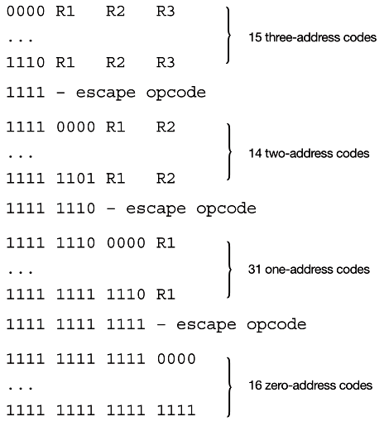
Instruction Formats
If we allow the length of the opcode to vary, we could create a very rich instruction set:
EX for 16-bit flexible instruction format

Slide 5
How Many Addresses should it be?
It is a basic design decision
More addresses
More complex (powerful?) instructions
More registers
Inter-register operations allow quicker and flexible
Fewer instructions per program
Fewer addresses
Less complex instructions
More instructions per program
Faster fetch/execution of instruction
Result in longer execution time, more complex for a program
Notes:
11

Slide 6
Addressing mode
Addressing modes specify where an operand is located.
They can specify (1) a constant, (2) a register, or (3) a memory location.
The actual location of an operand is its effective address (EA).
Certain addressing modes allow us to determine the address of an operand dynamically.

Slide 7
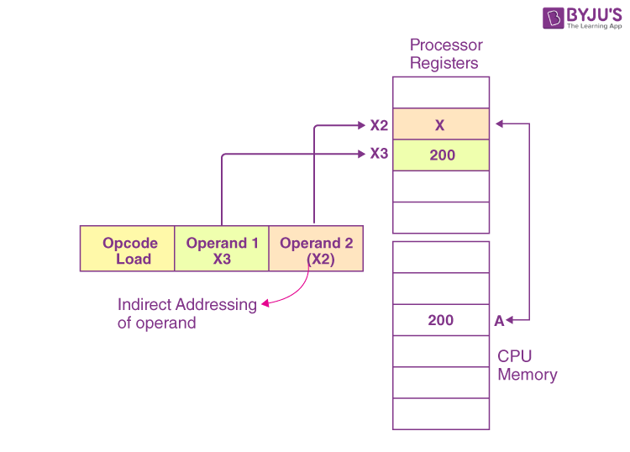
Direct and Indirect Addressing
Direct addressing is where the address of the data is given in the instruction.
Indirect addressing gives the address of the address of the data in the instruction.
In a higher-level language, we refer to it as pointers.
ADD X3, X2

Slide 8
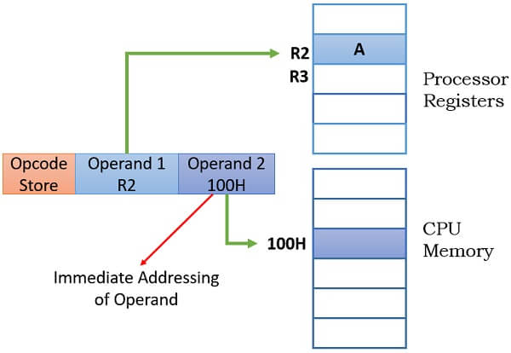
Register and Immediate addressing mode
Register addressing is where the data is located in a register.
Immediate addressing is where the data is part of the instruction.
Add R2, #100

Slide 9
Register indirect addressing mode
uses a register to store the address of the address of the data.
Load X3, (X2)
A

Slide 10
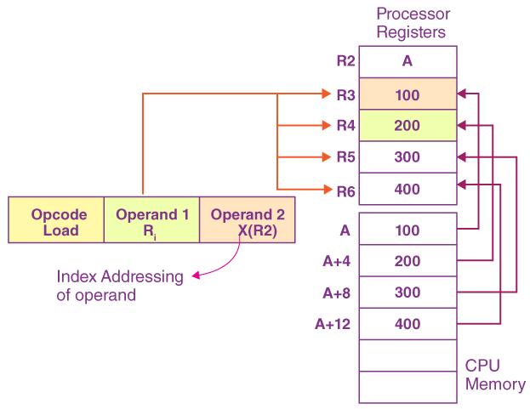
Indexed Addressing modes
uses a register (implicitly or explicitly) as an offset, which is added to the address in the operand to determine the effective address of the data.
Can help to access data in structure like Array
Load R2, A // direct
Load R3, (R2) // register indirect
Load R4, 4(R2) // indexed (base=R2, index=4)
Load R5, 8(R2)
Load R6, 12(R2)

Slide 11
Other methods of addressing
There are many variations to these addressing modes including:
Relative addressing
Similar to indexed which uses the operand as displacement from the base address (PC, base or index register)
Auto increment and decrement.
(R)+ , -(R) → Push vs Pop
Can be used to implement stack addressing
Indirect indexed addressing
We won’t cover these in detail.
Notes:
Self-relative is to use the current address as base and provide offset in the operand field

Slide 12
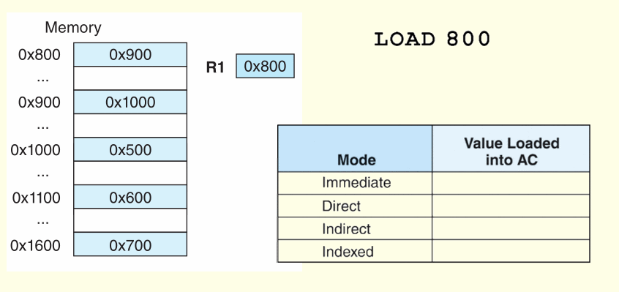
5.4 Addressing
For the instruction shown, what value is loaded into the accumulator for each addressing mode?

Slide 13
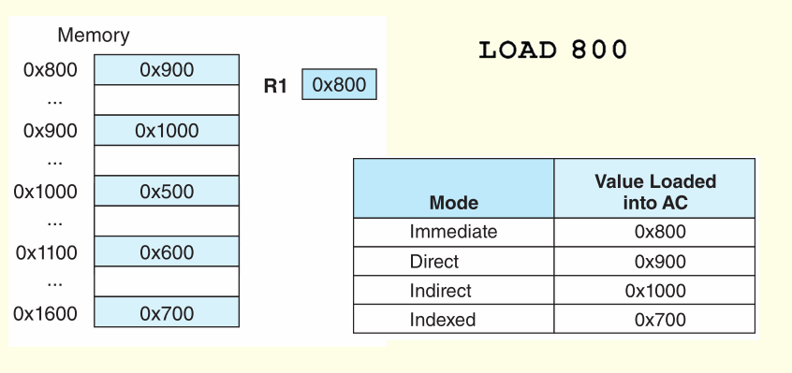
Addressing
For the instruction shown, what value is loaded into the accumulator for each addressing mode?

Slide 14
Instruction-Level Pipelining (ILP) http://www.intel.com/content/www/us/en/silicon-innovations/standards-14nm-explained-video.html

Slide 15
Instruction-Level Pipelining
Some CPUs divide the fetch-decode-execute cycle into smaller steps.
These smaller steps can often be executed in parallel to increase throughput.
Such parallel execution is called instruction-level pipelining (ILP).
The next slide shows an example of instruction-level pipelining.

Slide 16

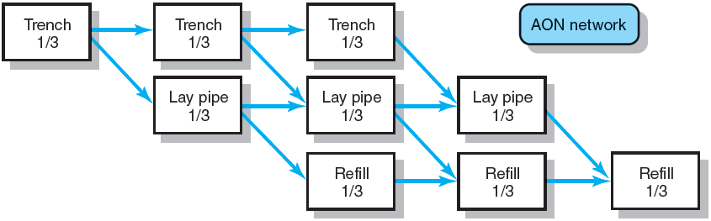
Example of executing small steps in parallel to increasing throughput: Laying the water pipe
FIGURE 6.12

Slide 17
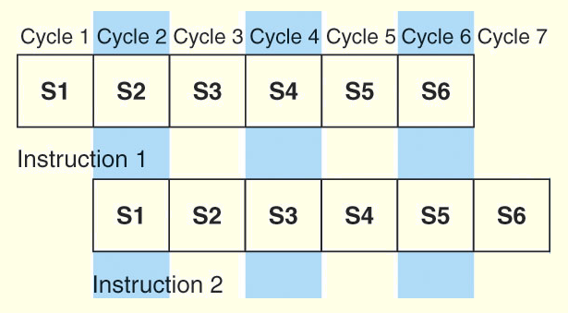
Instruction-Level Pipelining
Suppose a fetch-decode-execute cycle were broken into the following smaller steps:
So, we have a six-stage pipeline.
For every clock cycle, one small step is carried out, and the stages are overlapped.
S1. Fetch instruction. S4. Fetch operands.
S2. Decode opcode. S5. Execute instruction.
S3. Calculate effective S6. Store result.
address of operands.

Slide 18
Instruction-Level Pipelining
The theoretical speedup offered by a pipeline can be determined as follows, assume a program of n tasks:
-Let t_{p} be the time per stage. Each instruction represents a task, T, in the pipeline.
-The first task (instruction) requires k × t_{p} time to complete in a k-stage pipeline.
-The remaining (n - 1) tasks emerge from the pipeline one per clock cycle. So the total time to complete the remaining tasks is (n - 1)t_{p}.
Thus, to complete n tasks using a k-stage pipeline requires total time = (k × t_{p}) + (n - 1)t_{p} = (k + n - 1)t_{p} .
1. For a 6-stage pipeline, how many stages do we need for 5 tasks?
2. How many clock cycle for the traditional Fetch-decode-execute?
Notes:
For 6-stage = (6+5-1)tp = 10tp
For traditional, = (3+5-1)tp if assume that the instruction is breakable
= t_{n} = kt_{p} if assuming no break down

Slide 19


Instruction-Level Pipelining
If we take the time required to complete n tasks without a pipeline and divide it by the time it takes to complete n tasks using a pipeline, we find:
If we take the limit as n approaches infinity, (k + n - 1) approaches n, which results in a theoretical speedup of:
Notes:
n*t(n) = n*k*t(p)

Slide 20
Instruction-Level Pipelining
Our neat equations take a number of things for granted.
First, we have to assume that the architecture supports fetching instructions and data in parallel.
Second, we assume that the pipeline can be kept filled at all times. This is not always the case.
Pipeline hazards arise that cause pipeline conflicts and stalls.

Slide 21
Instruction-Level Pipelining
An instruction pipeline may stall, or be flushed for any of the following reasons:
Resource conflicts– read versus write to memory.
Data dependencies– need result from other instruction.
Conditional branching
Measures can be taken at the software level as well as at the hardware level to reduce the effects of these hazards, but they cannot be totally eliminated.
Notes:
Resource conflicts,e.g. one want to read, and another want to write into memory (resolv by 1) schedule with priority to execution over fetching, 2) make two separate path ways (for data and instruction)
Data dependencies ,e.g. need a result of one instruction as an operand, resolve by using h/w to insert no-op instruction, or with specialpathsbetween various stage, or compiler (sw) to reorder instruction
Conditional branch, solve by hw (predicting outcome of a conditional branch to know the next instruction to be execute) or compiler to delay the branch, e.g. to reorder and insert useful instruction (e.g. in worst case the no-op)

Slide 22
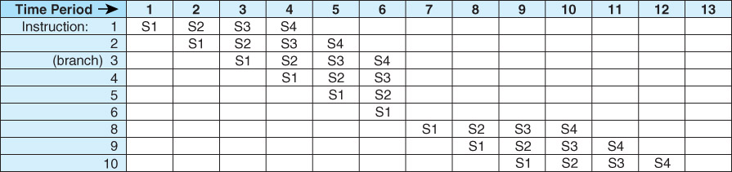
Figure 05.05
Example Instruction Pipeline with Conditional Branch

Slide 23
Real-World Examples of ISAs
Intel processors support a wide array of addressing modes.
The original 8086 provided 17 ways to address memory, most of them variants on the methods presented in this chapter.
Owing to their need for backward compatibility, the Pentium chips also support these 17 addressing modes.
The Itanium, having a RISC core, supports only one: register indirect addressing with optional post increment. – not successful.

Slide 24
Real-World Examples of ISAs
Intel introduced pipelining to their processor line since the introduction of Pentium chip.
The first Pentium (x86 32-bit architecture) had two five-stage pipelines. Each subsequent Pentium processor had a longer pipeline than its predecessor with the Pentium IV having a 24-stage pipeline.
The Itanium (IA-64) has only a 10-stage pipeline.
The Core i series has 5 - 20 stages pipeline.

Slide 25
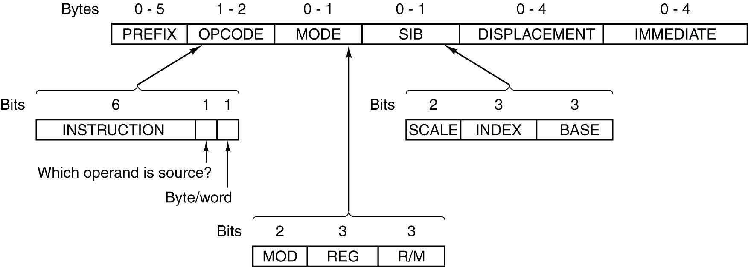
The Pentium 4 Instruction Formats
17 addressing modes; Support 8, 16, 32 bits operand
Flexible instruction format
Compatible with the old 8080 CPU’s assembly

Slide 26
Real-World Examples of ISAs
MIPS was an acronym for Microprocessor Without Interlocked Pipeline Stages.
The architecture is little endian and word-addressable with three-address, fixed-length instructions.
Used in RISC architecture of Silicon Graphics (SGI)
Cisco routers, the original Sony PlayStations (R3000a),
PS5 uses AMD ZEN 2 (CISC x86 64 CISC architecture)
Still use in embedded system like printers (if not android)
Mostly replaced by ARM
Like Intel, the pipeline size of the MIPS processors has grown: The R2000 and R3000 have five-stage pipelines; the R4000 and R4400 have 8-stage pipelines.

Slide 27
Real-World Examples of ISAs
The R10000 has three pipelines: A five-stage pipeline for integer instructions, a seven-stage pipeline for floating-point instructions, and a six-stage pipeline for LOAD/STORE instructions.
In all MIPS ISAs, only the LOAD and STORE instructions can access memory.
The ISA uses only base addressing mode.
The assembler accommodates programmers who need to use immediate, register, direct, indirect register, base, or indexed addressing modes.

Slide 28
Real-World Examples of ISAs
The Java programming language is an interpreted language that runs in a software machine called the Java Virtual Machine (JVM).
A JVM is written in a native language for a wide array of processors, including MIPS, ARM and Intel.
Like a real machine, the JVM has an ISA all of its own, called bytecode. This ISA was designed to be compatible with the architecture of any machine on which the JVM is running.
The next slide shows how the pieces fit together.

Slide 29
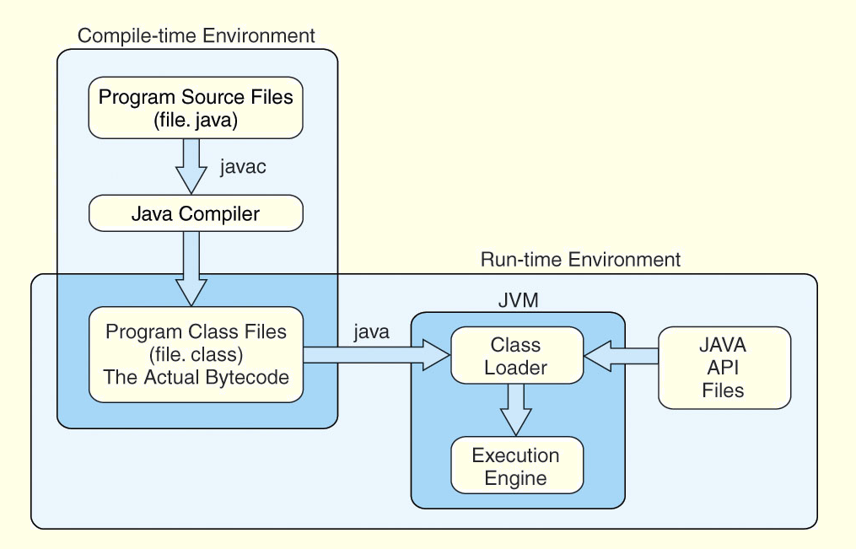
Real-World Examples of ISAs

Slide 30
Real-World Examples of ISAs
Java bytecode is a stack-based language.
Most instructions are zero address instructions.
The JVM has four registers that provide access to five regions of main memory.
All references to memory are offsets from these registers (indexed addressin). Java uses no pointers or absolute memory references.
Java was designed for platform interoperability, not performance!

Slide 31
Real-World Examples of ISAs
ARM is the most widely used 32-bit instruction architecture:
95%+ of smartphones,
80%+ of digital cameras
40%+ of all digital television sets
Founded in 1990, by Apple and others, ARM (Advanced RISC Machine) is now a British firm, ARM Holdings.
ARM Holdings does not manufacture these processors; it sells licenses to manufacture.

Slide 32
Real-World Examples of ISAs
ARM is a load/store architecture : all data processing must be performed on values in registers, not in memory.
It uses fixed-length, three-operand instructions and simple addressing modes
ARM processors have a minimum of a three-stage pipeline (consisting of fetch, decode, and execute);
Newer ARM processors have deeper pipelines (more stages). Some ARM8 implementations have 13-stage integer pipelines

Slide 33
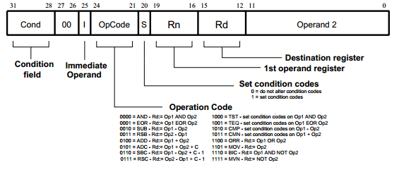
ARM Instruction format for the 32-bit version.
Fixed length, 3-operand ISA

Slide 34
Real-World Examples of ISAs
ARM has 37 total registers but their visibility depends on the processor mode.
Intel Pentium, there were up to 128 registers
ARM allows multiple register transfers.
It can simultaneously load or store any subset of the16 general-purpose registers from/to sequential memory addresses.
Control flow instructions include unconditional and conditional branching and procedure calls
Most ARM instructions execute in a single cycle, provided there are no pipeline hazards or memory accesses.

Slide 35
Conclusion
Instruction format can be flexible and complex (CISC) or simple format (RISC)
Instruction could be equipped with many possible addressing mode for fetching operands.
Instruction can be speeded up using instruction-level pipelining.
In real-world, various approach of ISA have been evolved, Intel, AMD, MIPS, ARM, even the virtual machine like JAVA JVM.
Further reading
Addressing mode https://byjus.com/gate/index-addressing-mode-notes/
ISA definition https://www.youtube.com/watch?v=6fgbLOL7bis

